Slide 1


Jakub Khan
17.08.2023

Slide 2

Outline
Executive Summary
Introduction
Methodology
Results
Conclusion
Appendix

Slide 3
Executive Summary
Methodologies
Data Collection
Data Wrangling
Exploratory Data Analysis
Interactive Visual Analysis
Predictive analysis
Results
Exploratory Data Analysis in Visualizations
Interactive Analytical Map and Dashboard
Predictive Classification Model

Slide 4
Introduction
I have been instructed to predict the probability of a successful landing of the first stage of SpaceX's Falcon 9 launch system, as this information will enable my client to assess its competitiveness, since the recovery of the first stage makes it profitable for SpaceX to set its price at $62 million per launch, far lower than any competitor. I need to gather information on past flight records and find out what factors and conditions determine a successful landing in order to accomplish my mission.

Slide 5

Section 1

Slide 6
Methodology
Data collection methodology:
Data was obtained by SpaceX API calls
Web scraping using Beautiful Soup from Wikipedia
Data wrangling
Categorical Features trough one-hot encoding for ML and general data cleaning
Exploratory data analysis (EDA) using visualization and SQL
Interactive visual analytics using Folium and Plotly Dash
Predictive analysis using classification models
Logistic regression, k-nearest neighbor, support vector machines and decision tree models have been built and tested for best accuracy

Slide 7
Data Collection
SpaceX API Calls
Request and Parse SpaceX launch data using Get Requests
Decode the Response as Json and turn into pandas Dataframe
Construct dataset by assigning relevant data columns to lists later combined in a dictionary which is then turned into our Dataframe
Filter data to exclusively feature Falcon 9 launch vehicles into new updated Dataframe
Web Scraping
Perform HTTP Get request from Wikipedia
Turn HTML response into BeautifulSoup object
Extract table with relevant data and parse html launch tables into dictionary
Turn dictionary of table values into dataframe
Send Request
Transform Response
Create Dataset

Slide 8

Data Collection – SpaceX API
Request and parse SpaceX launch data using Get Requests:
Decode the response as Json and turn into pandas dataframe:
Construct dataset by assigning relevant data columns to lists later combined in a dictionary which is then turned into our dataframe:
Filter data to exclusively feature Falcon 9 and update dataframe flight number column:
https://github.com/Tyrannos3/IBM_Data_Science_Capstone_Labs.git

Slide 9
Data Collection - Scraping
Perform HTTP Get request from Wikipedia:
Turn HTML response into BeautifulSoup object:
Extract table with relevant data and parse html launch tables into dictionary :
Turn dictionary of table values into dataframe:

Slide 10
Data Wrangling
Replace payload mass null values with mean
Split landing outcome values relative to their success or failure in two lists
Create ‘Class’ Column, iterating trough landing outcome success/failure lists, and append outcome as binary, where 1=Success and 0=Failure

Slide 11
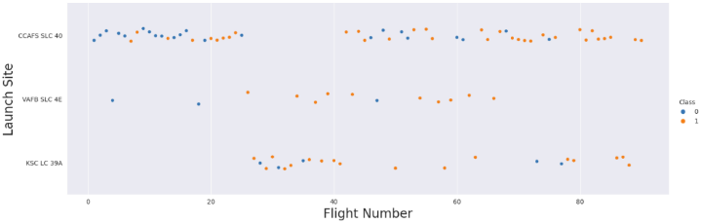
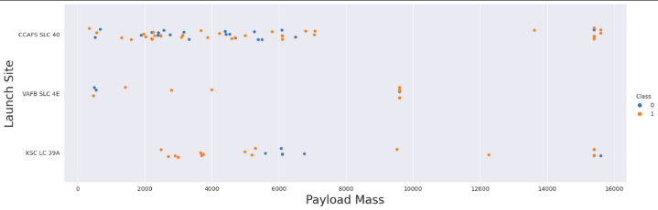
EDA with Data Visualization
Relationship between launch site and success rate over time:
Relationship between launch site and Payloadmass:

Slide 12
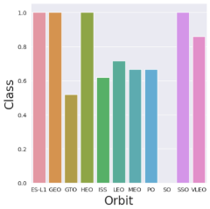
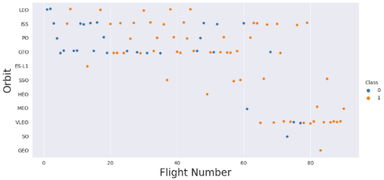
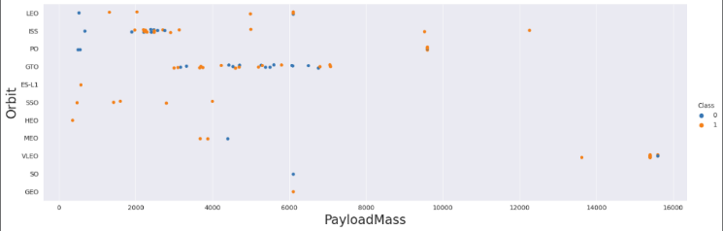
EDA with Data Visualization
Relationship between orbit and success rate over time:
Relationship between Orbit and payload mass:

Slide 13
EDA with SQL
Names of unique launch sites in mission
5 records where launch sites begin with 'CCA’
Total payload mass carried by boosters launched by NASA
Average payload mass carried by booster version F9 v1.1
First succesful landing outcome in ground pad
Success in drone ship and have payload mass greater than 4000 but less than 6000
Total number of successful and failure mission outcomes
Names of booster versions which have carried the maximum payload mass
Records which will display the month names, months in year 2015
Landing outcomes between the date 2010-06-04 and 2017-03-20

Slide 14
Build an Interactive Map with Folium
Markers are utilized to visualize the launch sites and every launch record with the marker color indicating mission success or failure
Clusters were used to simplify the map as it contains many markers with the same coordinate
Circles were superimposed on the launch markers to signal their location
Lines were used to showcase the nearby points of interest

Slide 15
Build a Dashboard with Plotly Dash
Dropdown menu to give information on different launch sites
Pie Chart with callback function to visualize launch success rate for selected site
Range slider to select certain payload mass
Scatterplot rendered by callback function to be sensitive towards the chosen site

Slide 16
Predictive Analysis (Classification)
Numpy Array was created from Column ‘Class’ which holds launch success data as biary
Standardized the data in X then reassigned it to the variable X
Used the function train_test_split to split the data X and Y into training and test data, setting the parameter test_size to 0.2 and random_state to 2
Created a logistic regression, support vector machine, decision tree and k nearest neighbors object and with them a GridSearchCV object fitting them with the train data to find the best parameters then I calculated the accuracy on the test data using the method score
I found the best model by comparing the accuracy of each method
Create a NumPy array from the column Class in data

Slide 17
Results
Exploratory data analysis results
Interactive analytics demo in screenshots
Predictive analysis results

Slide 18

Section 2

Slide 19
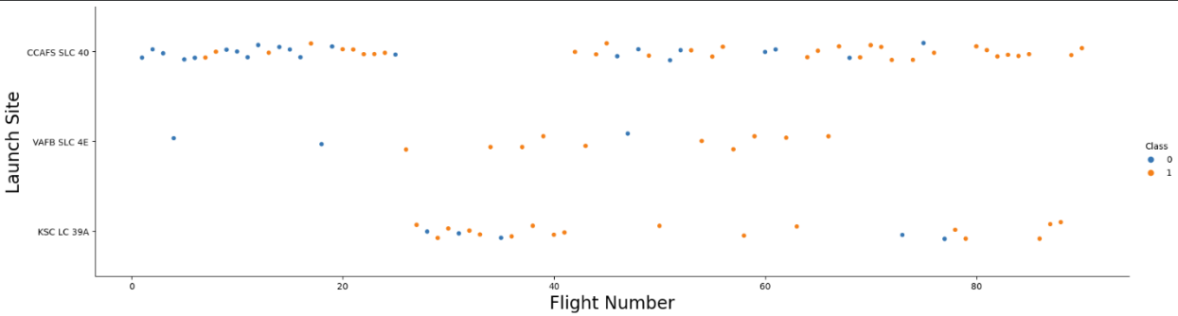
Flight Number vs. Launch Site
Since the first 20 flights were almost exclusively launched from Cape Canaveral, with very high landing failure rates, this explains the lower overall success rate for this site.

Slide 20
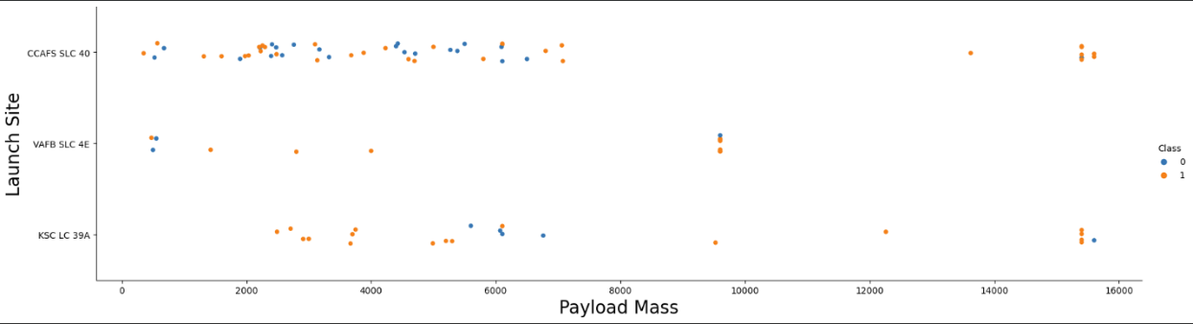
Payload vs. Launch Site
Launch sites are payload mass specific, with VAFB not hosting a single higher payload mass launch.

Slide 21
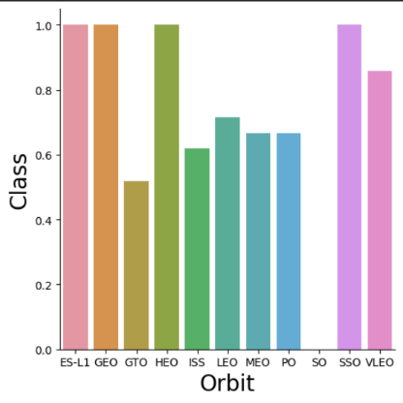
Success Rate vs. Orbit Type
Missions to ES-L1, GEO, HEO and SSO orbits have a perfect record

Slide 22
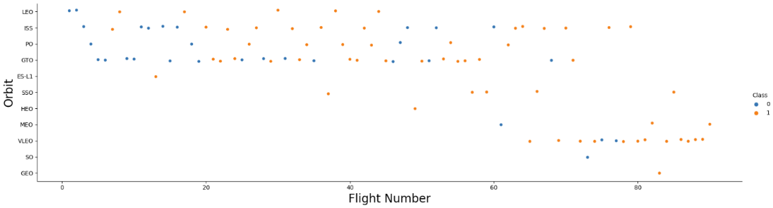
Flight Number vs. Orbit Type
The success rate in LEO orbit seems to be related to the number of flights, but there seems to be no relationship with the number of flights in GTO orbit

Slide 23
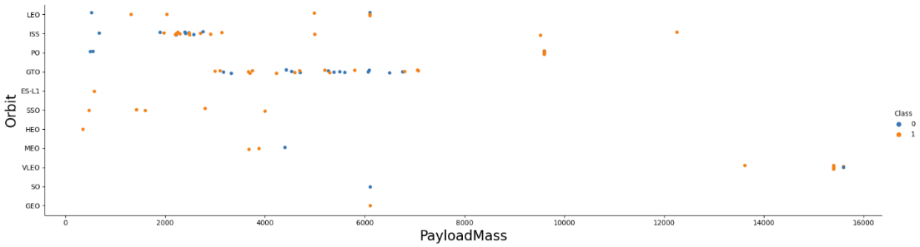
Payload vs. Orbit Type
The successful landing rate for heavy payload launches is higher for PO, LEO and ISS

Slide 24
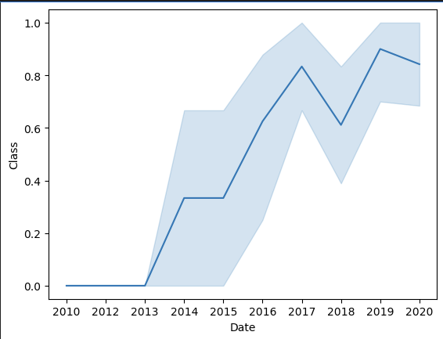
Launch Success Yearly Trend
From 2013, the success rate increased dramatically, with a dip in 2018

Slide 25
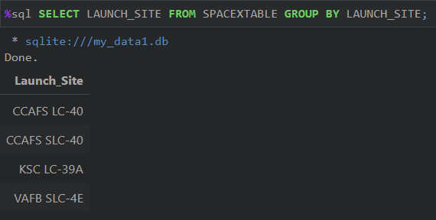
All Launch Site Names
The Names of unique launch sites in missions can be obtained by selecting the launch site from the spaceX table and combining the launch sites in groups

Slide 26
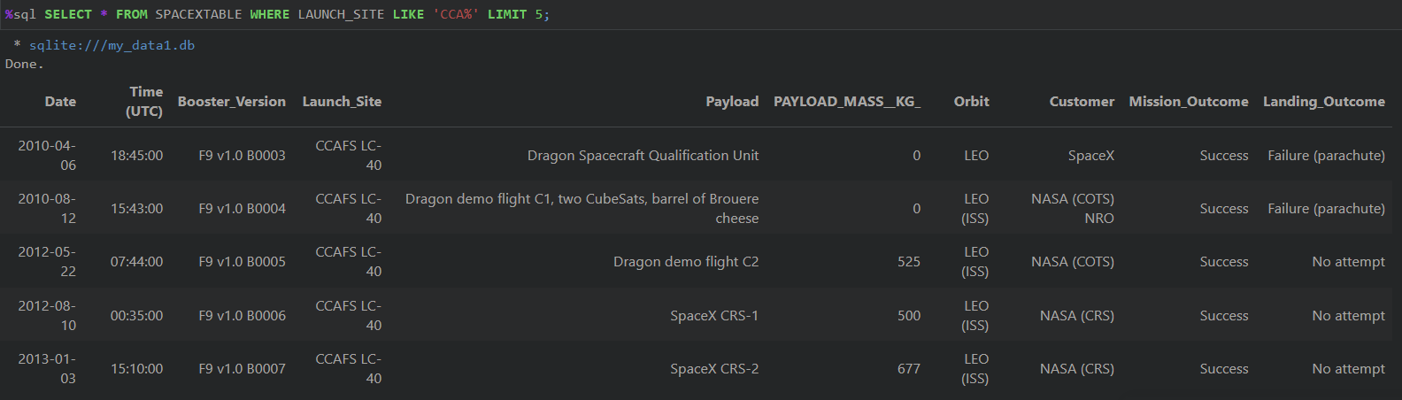
Launch Site Names Begin with 'CCA'
This query shows 5 Record from Cape Canaveral by selecting everything from SpaceX table where the first letters of the launch site are identical to CCA

Slide 27
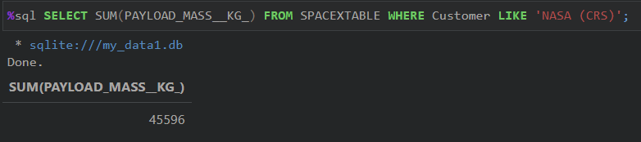
Total Payload Mass
The total payload carried by boosters from NASA by adding all Payload mass Kg values whilst only including NASA customer records

Slide 28
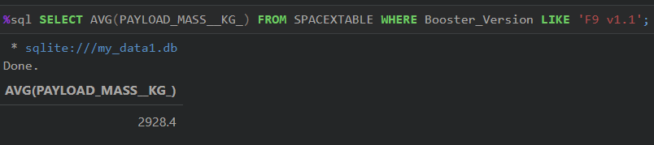
Average Payload Mass by F9 v1.1
The average payload mass carried by booster version F9 v1.1 is obtained by using the AVG function on the payload mass column whilst setting a condition for the desired booster version

Slide 29
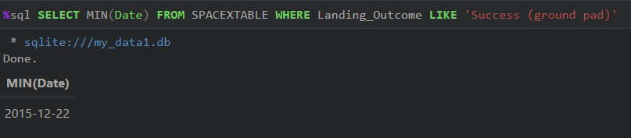
First Successful Ground Landing Date
The first successful landing outcome on ground pad was achieved on the 22nd of December 2015 and you find this record by selecting the minimum Date from the SpaceX table where the landing outcome is filtered for ground pad results

Slide 30
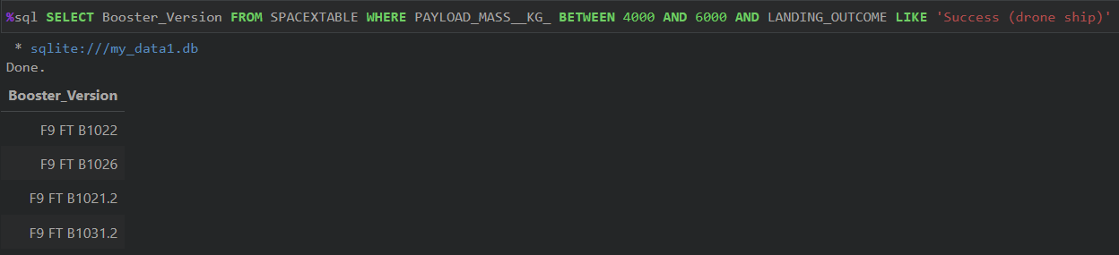
Successful Drone Ship Landing with Payload between 4000 and 6000
Boosters which have successfully landed on drone ship and had payload mass greater than 4000 but less than 6000 have been found by using 2 conditions which first checks for the desired payload mass and second filters records that are akin to a successful drone ship landing

Slide 31
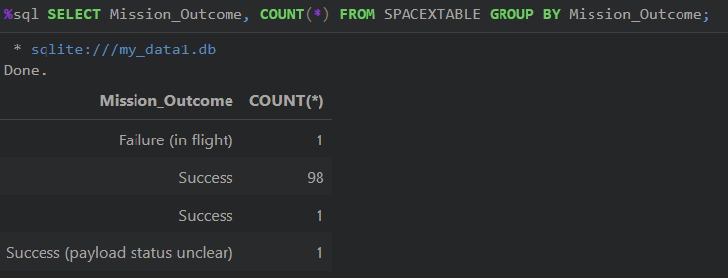
Total Number of Successful and Failure Mission Outcomes
Calculating the total number of successful and failure mission outcomes can be achieved by counting all records grouped by the selected mission outcome

Slide 32

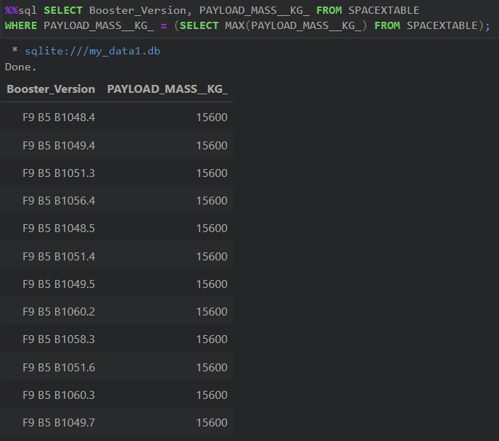
Boosters Carried Maximum Payload
A List with names of the booster which have carried the maximum payload mass can be obtained by using a subquery which filters for the maximal payload mass

Slide 33
2015 Launch Records
Failed drone ship landing outcomes for the year 2015 can be displayed by selecting the month with the help of substr, booster version, launch site and landing outcome columns from the spaceX table where the landing outcome is conditioned to Failures involving a drone ship and the year in question using substr

Slide 34
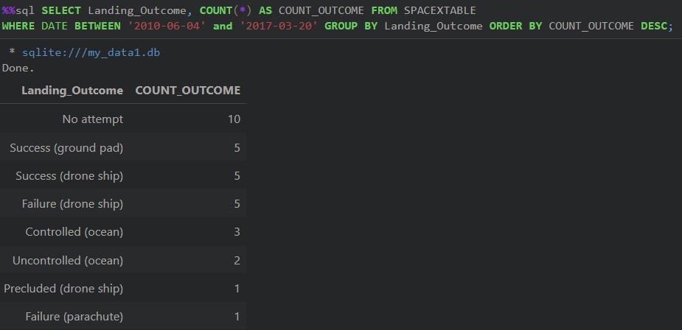
Rank Landing Outcomes Between 2010-06-04 and 2017-03-20
Ranking the count of landing outcomes between the date 2010-06-04 and 2017-03-20, in descending order can only be achieved by using no less than 3 conditions after selecting the landing outcome column and counting all records from SpaceX table

Slide 35

Section 3

Slide 36
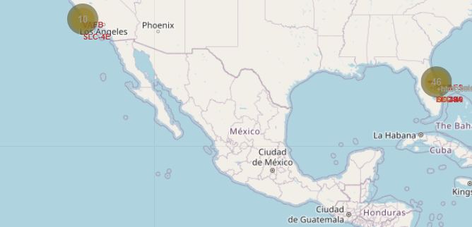
Interactive Launch Map
All Launch Sites have been Added including each individual Launch Record

Slide 37
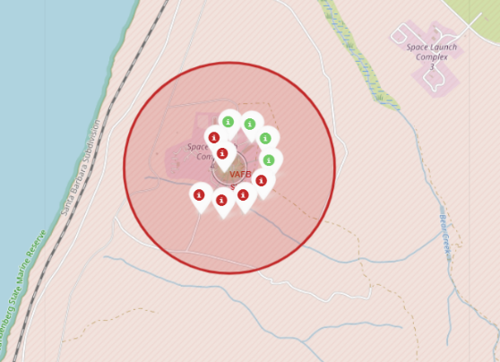
Launch Record Success
Launch Records have been color coded to easily identify launch success

Slide 38
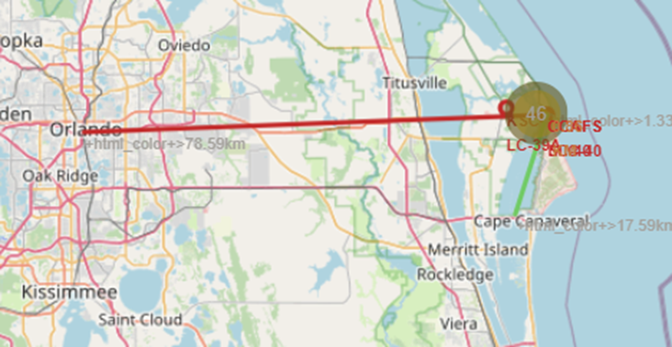
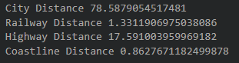
Launch Site proximities
Lines indicating the distance of Cape Canaveral's proximities like a City, railway, highway, costline have been added and evaluated

Slide 39

Section 4

Slide 40
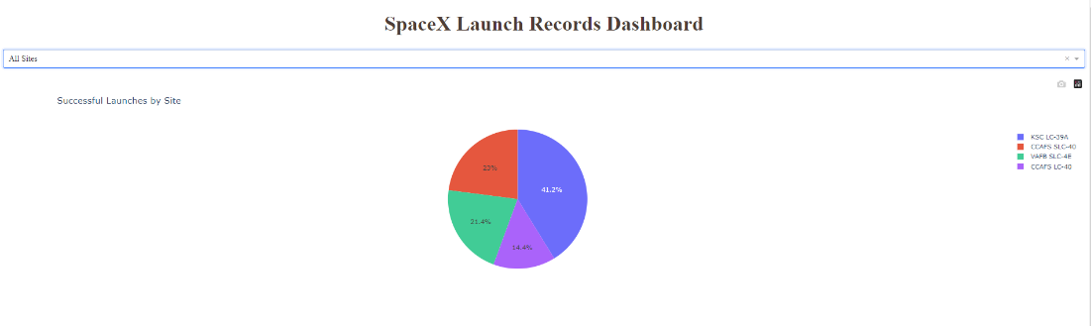
Launch Success Dashboard
The Kennedy Space Center Launch Complex has the lion share of successful launches with 41.2%

Slide 41
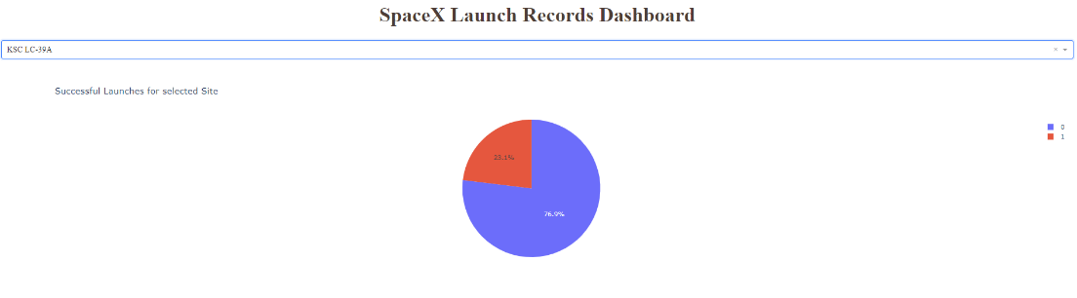
Kennedy Space Center in Depth
76.2% of all the launches hosted by the Kennedy Space Center Launch Complex were successful

Slide 42
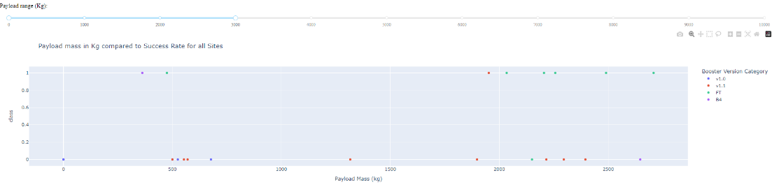
Interactive Payload Selection
The data indicates that lower payload weight is associated with higher launch success

Slide 43

Section 5

Slide 44
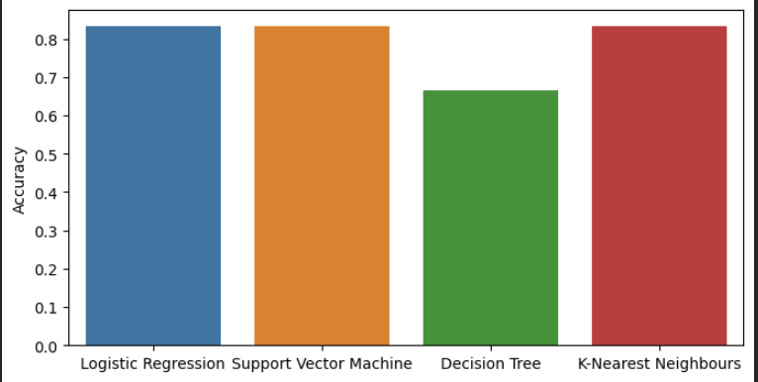
Classification Accuracy
The Logistic Regression, SVM and KNN Models performed equally well, achieving a model accuracy of 83.3%

Slide 45
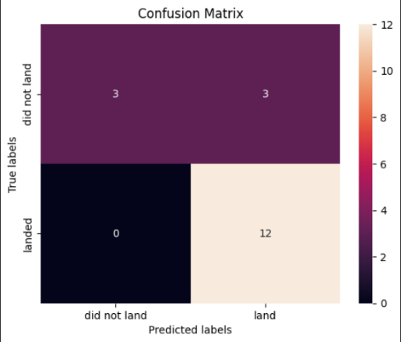
Confusion Matrix
The Logistic Regression, SVM and KNN Models have the exact same Confusion Matrix results with a accuracy of 83.3%

Slide 46
Conclusions
In conclusion, the Logistic Regression, SVM and KNN models are equally good at predicting future first stage landing success of the Falcon 9 Rocket, while the Decision Tree model is not recommended as it is not only inferior in accuracy, but the results are also inconsistent. The launch success rate also plays a role, but it has steadily increased over time and is now less of a factor with a success rate of over 80%.

Slide 47
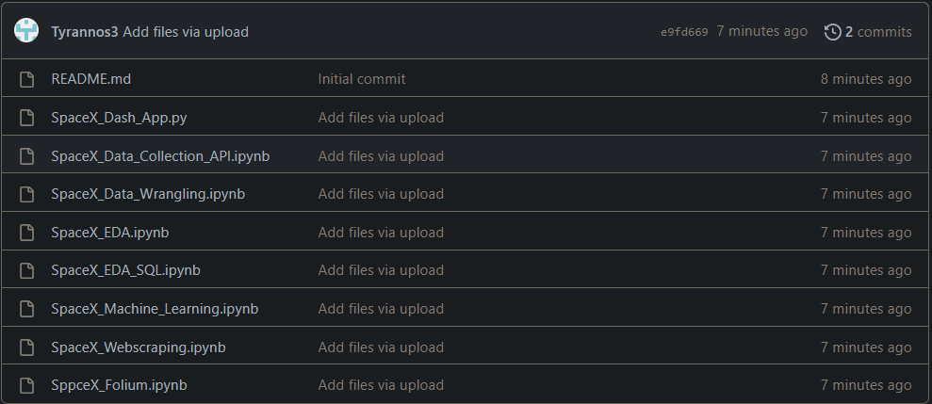
Appendix

Slide 48
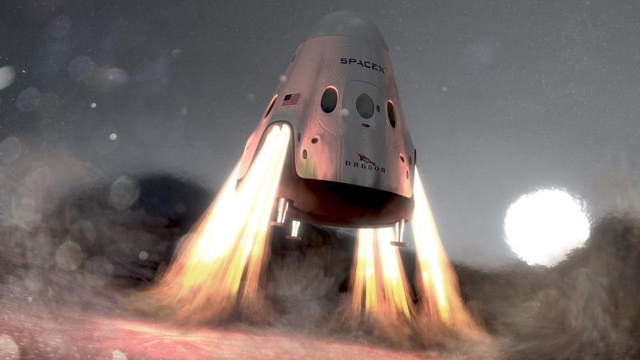
Thank You!

